Slide 1
Student Organization Registration Meeting
Notes:
Connie welcome

Slide 2
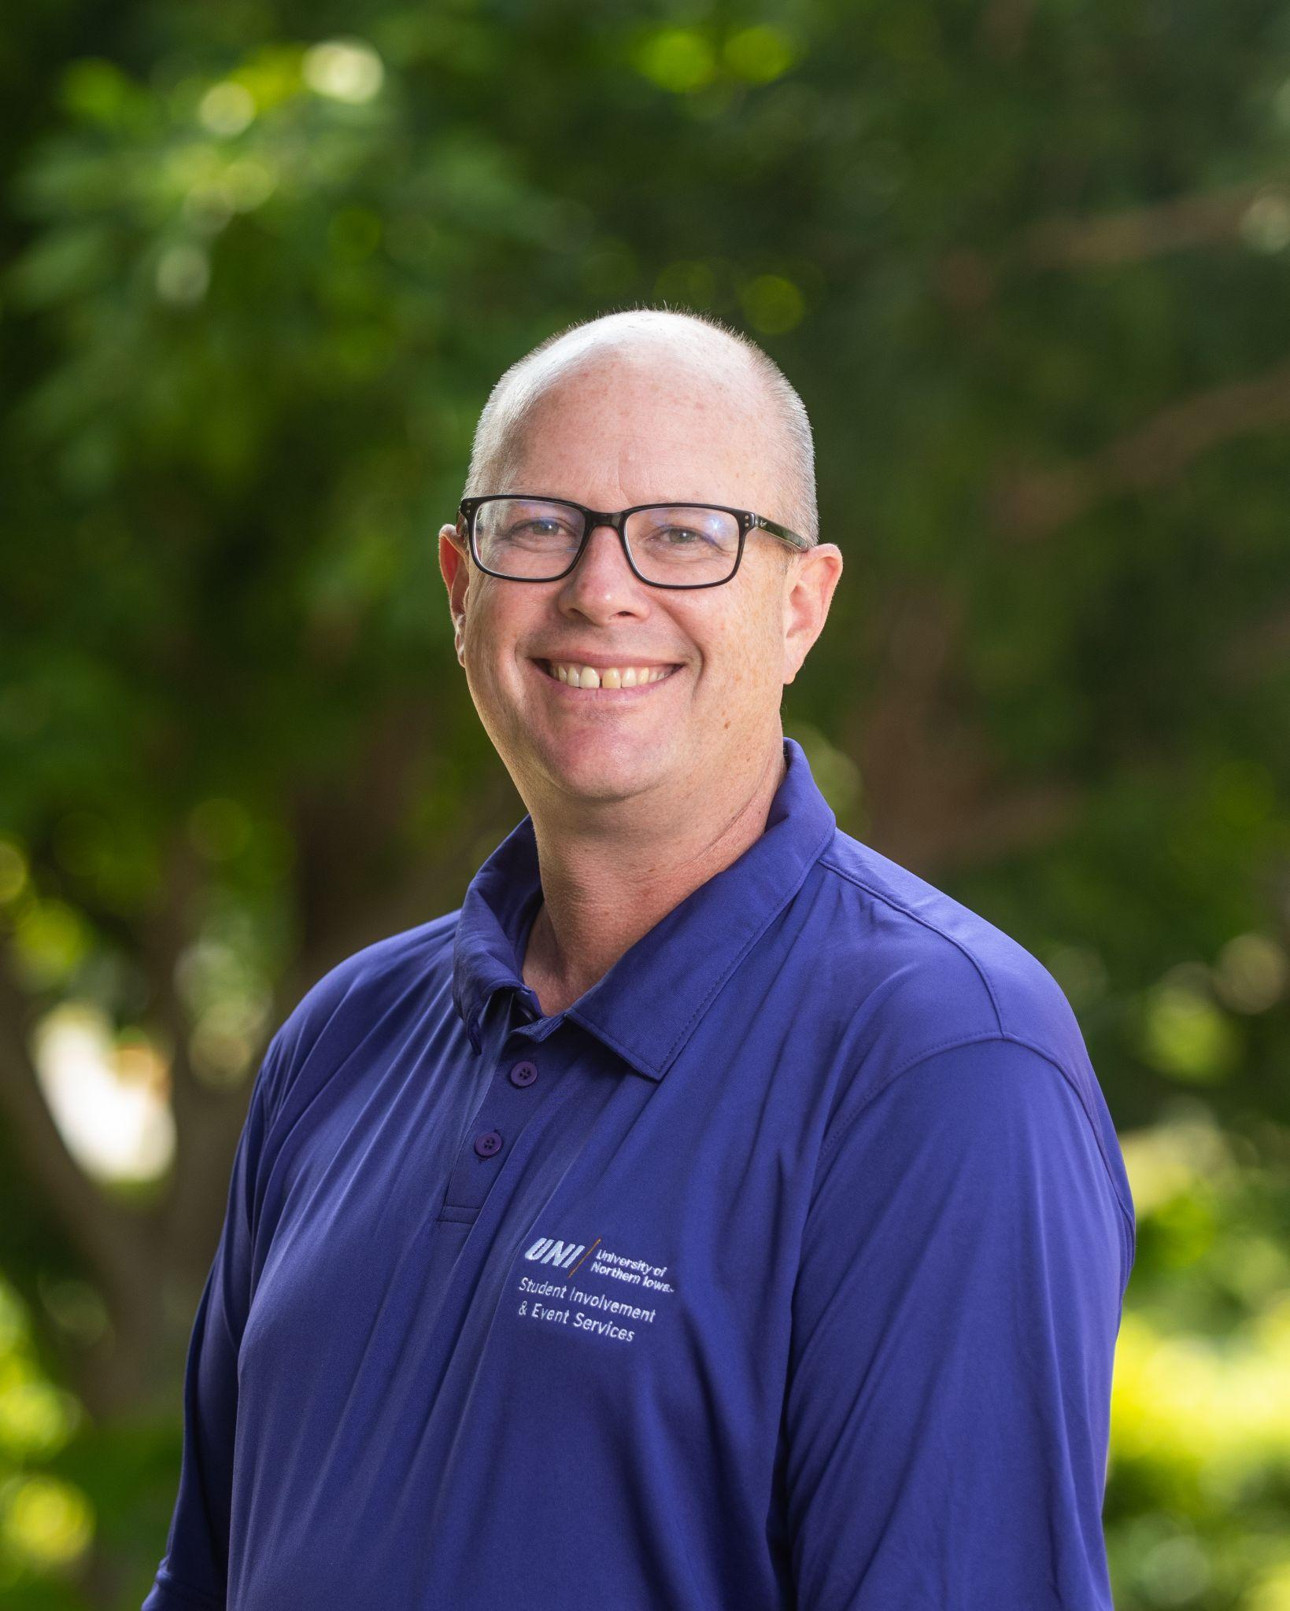
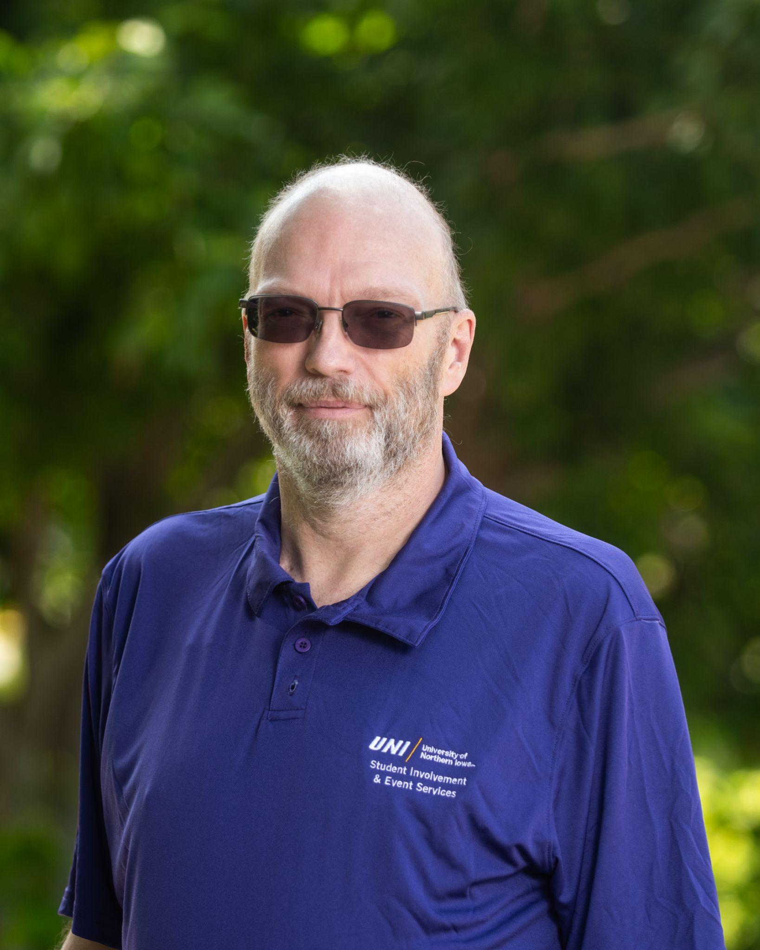
Event Services Staff
Mike Bobeldyk, Director
Primary Contact for Events in the Maucker Union
Secondary Contact for Outdoor Events
Northern Iowa Student Government
Bryan Beardsley, Business and Operations Manager
Primary Contact for Outdoor Events & Lang Hall Events
Secondary Contact for Events in Maucker Union
Notes:
Connie

Slide 3
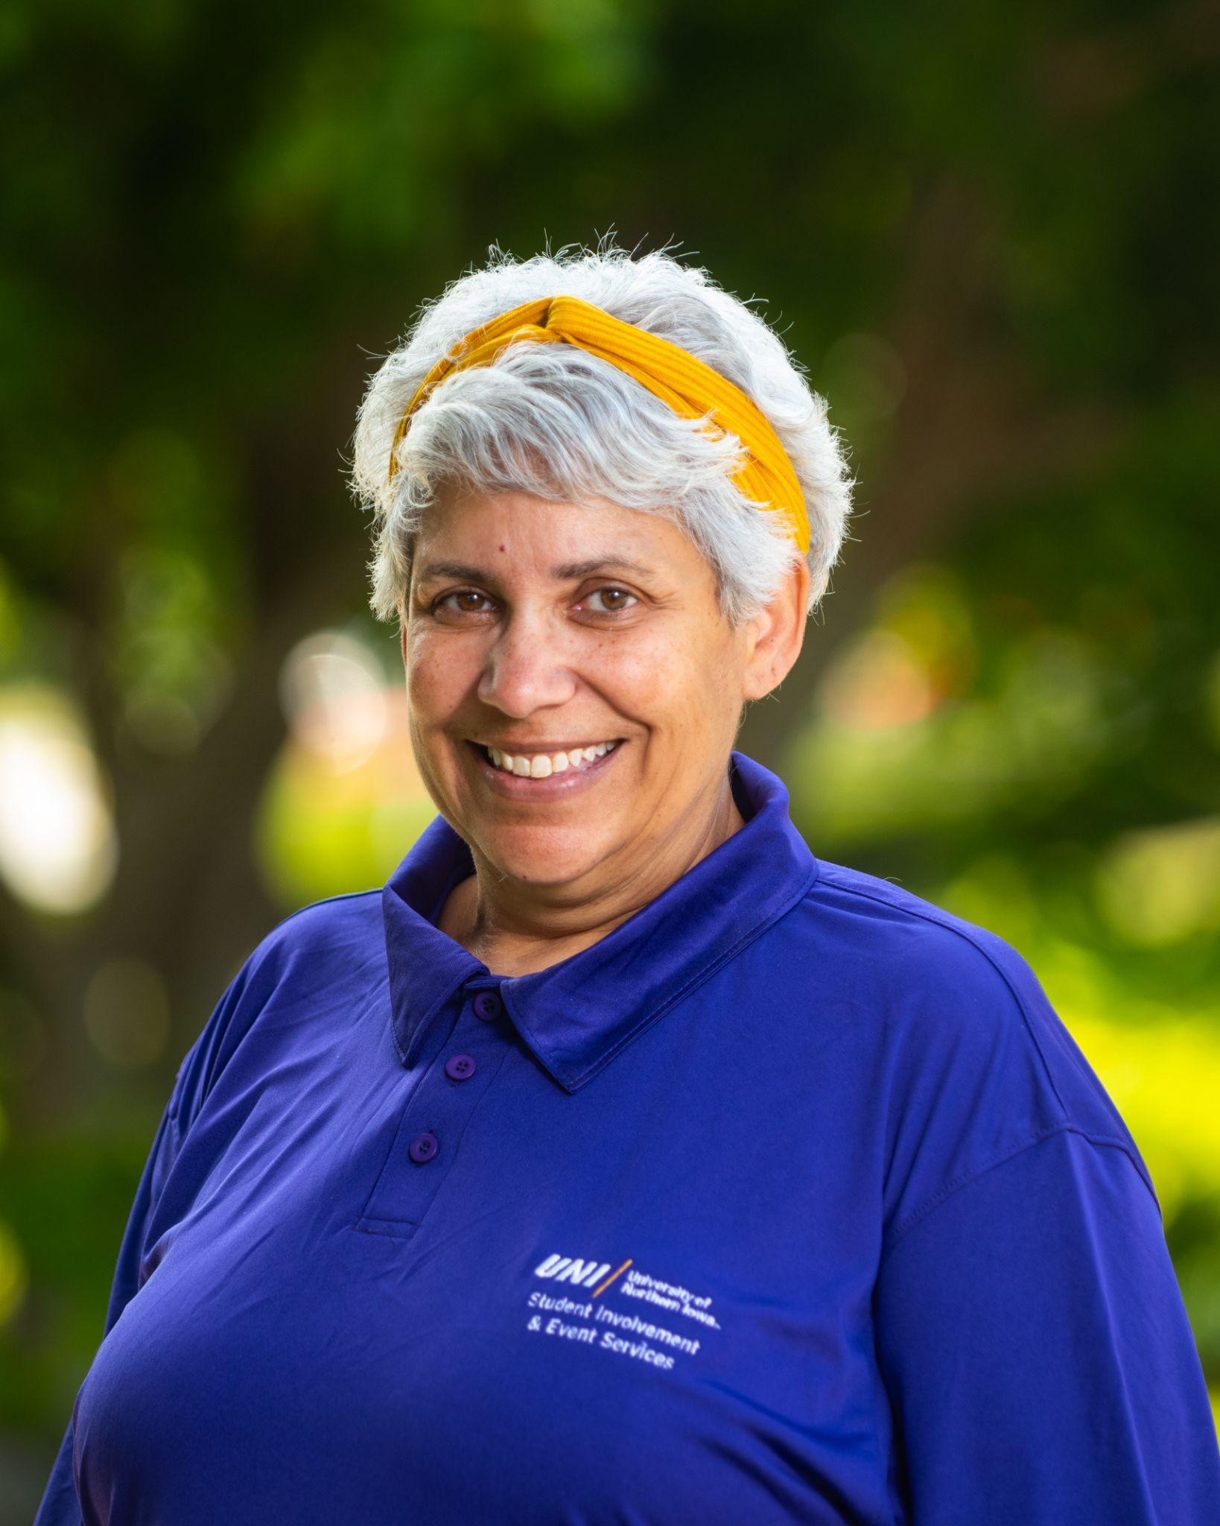
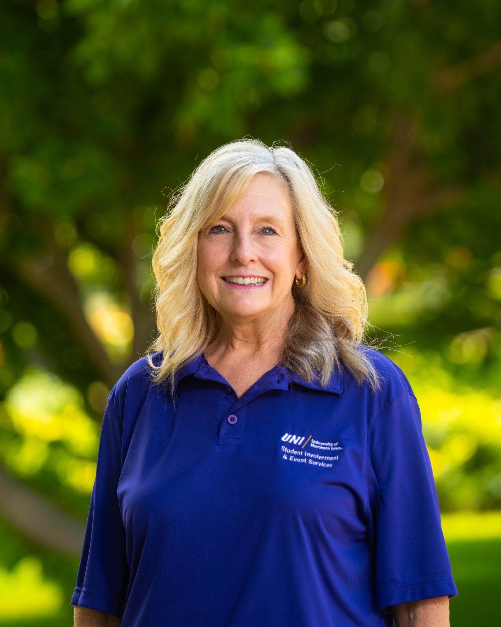
Student Involvement Staff
Connie Hansen, Associate Director
Panther Pantry
Panther FYI
Student Organization Support
Pam Creger, Secretary
NISG Funding
Student Organization Start up
Student Organization Resources
Notes:
Connie

Slide 4
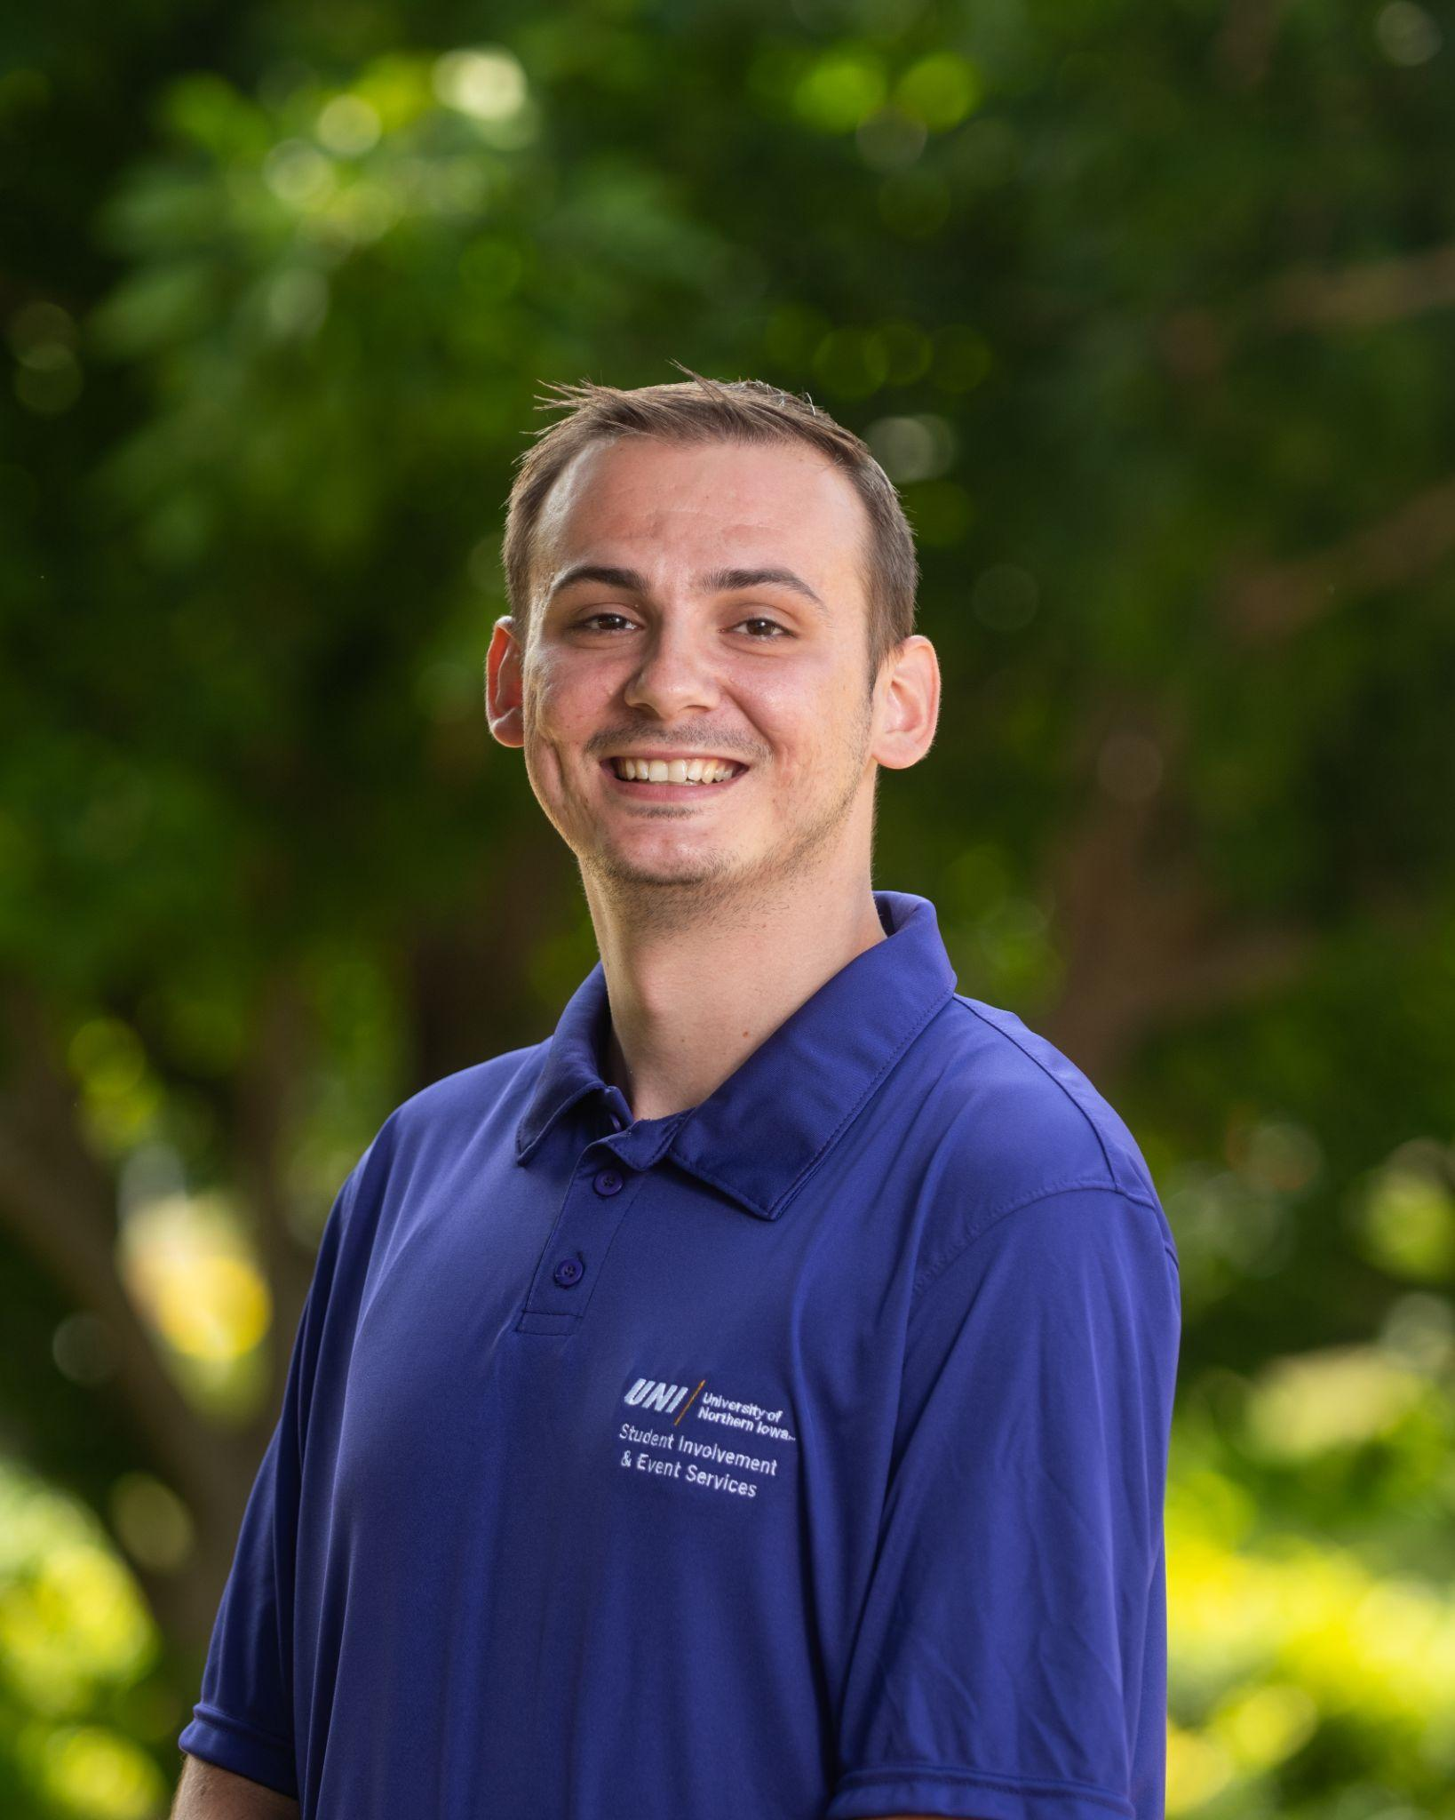
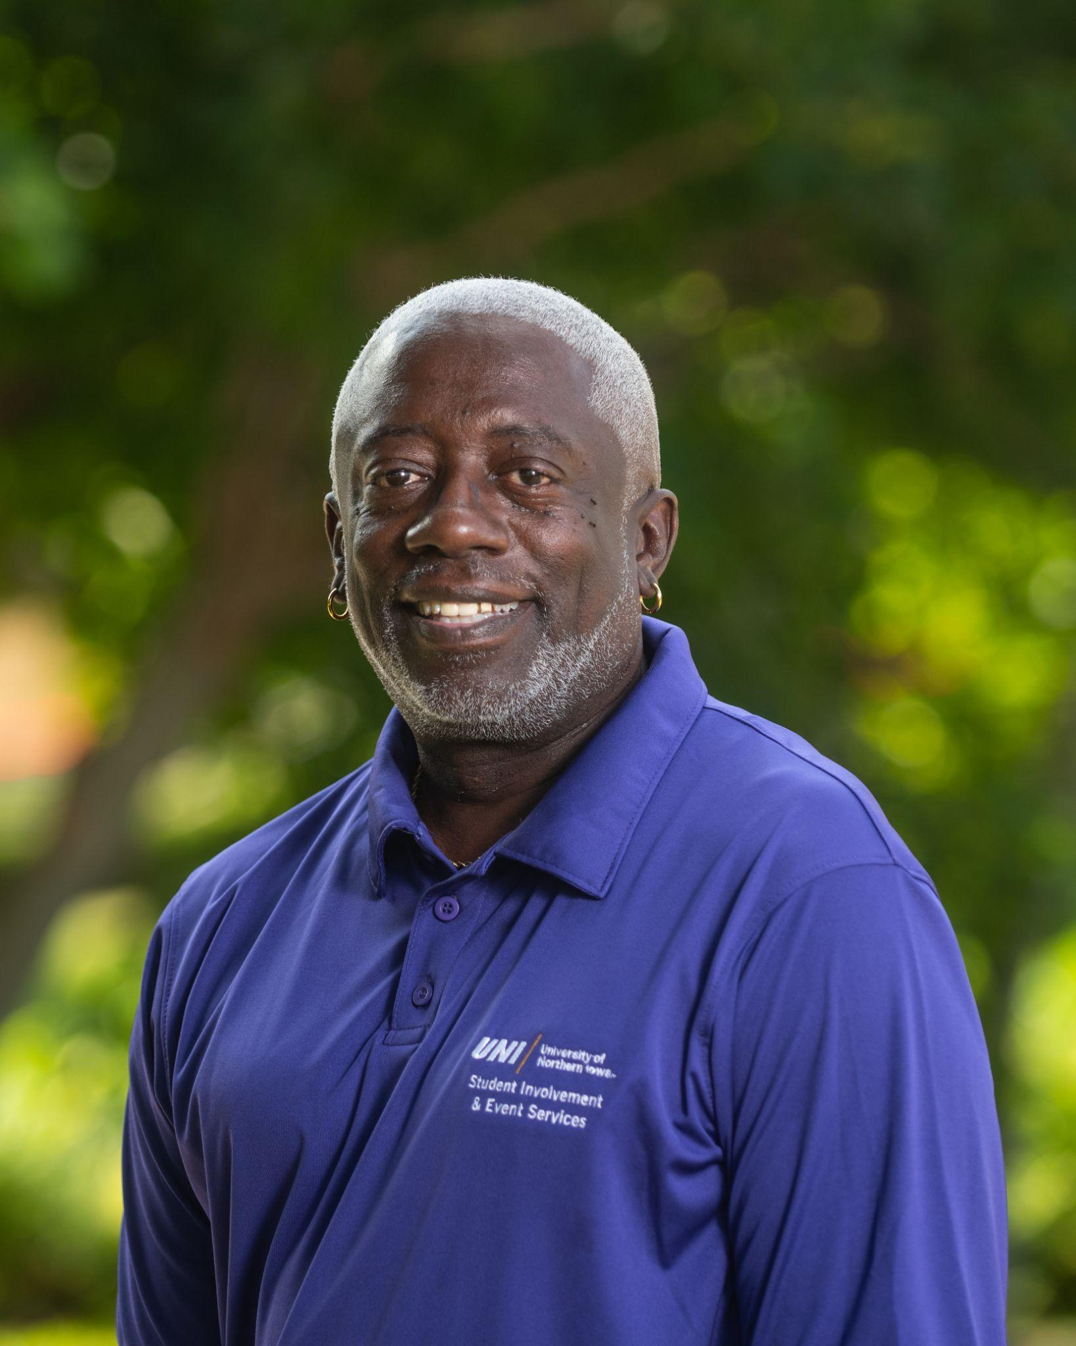
Student Involvement Staff
Josh Farris
Campus Programs Coordinator
Fraternity & Sorority Life
Student Organizations Support
Carlos Frazier
Campus Programs Coordinator
Student Organization Leadership/Workshops
Student Leader Organizational Contact
Notes:
Connie

Slide 5
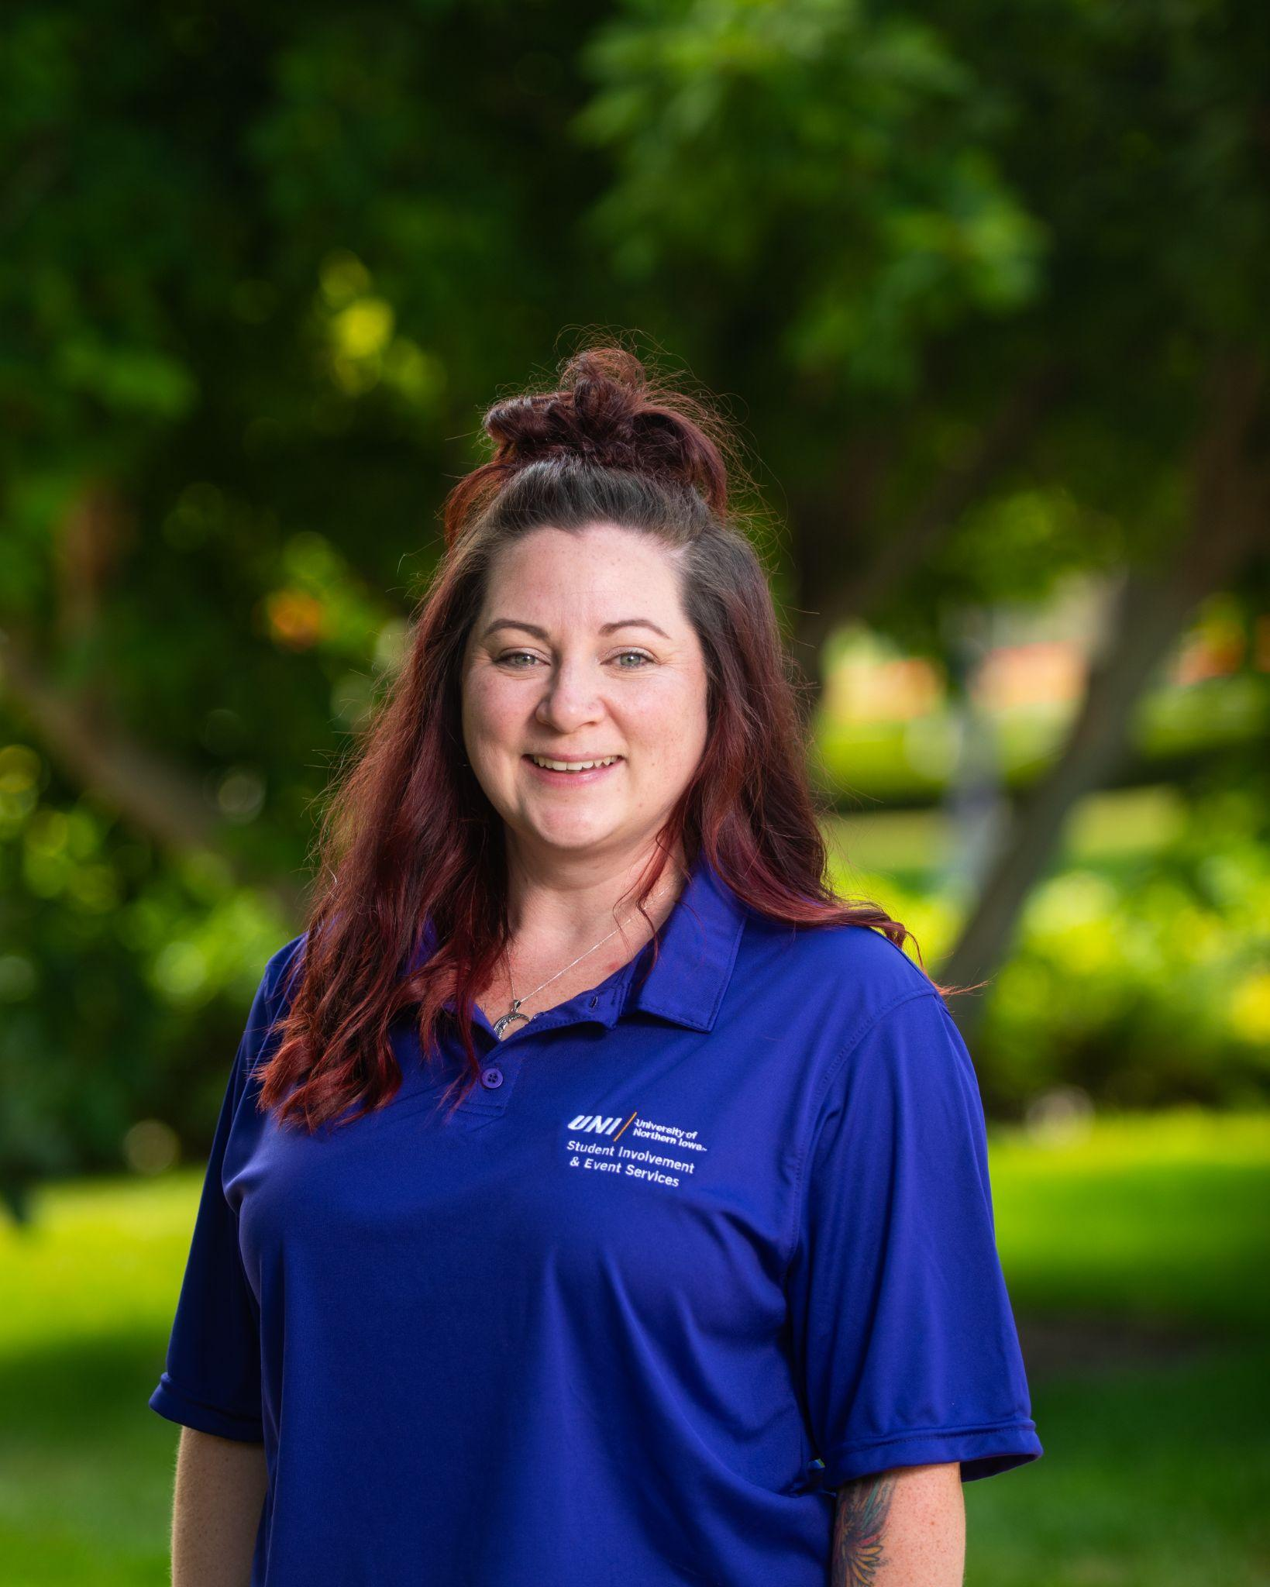
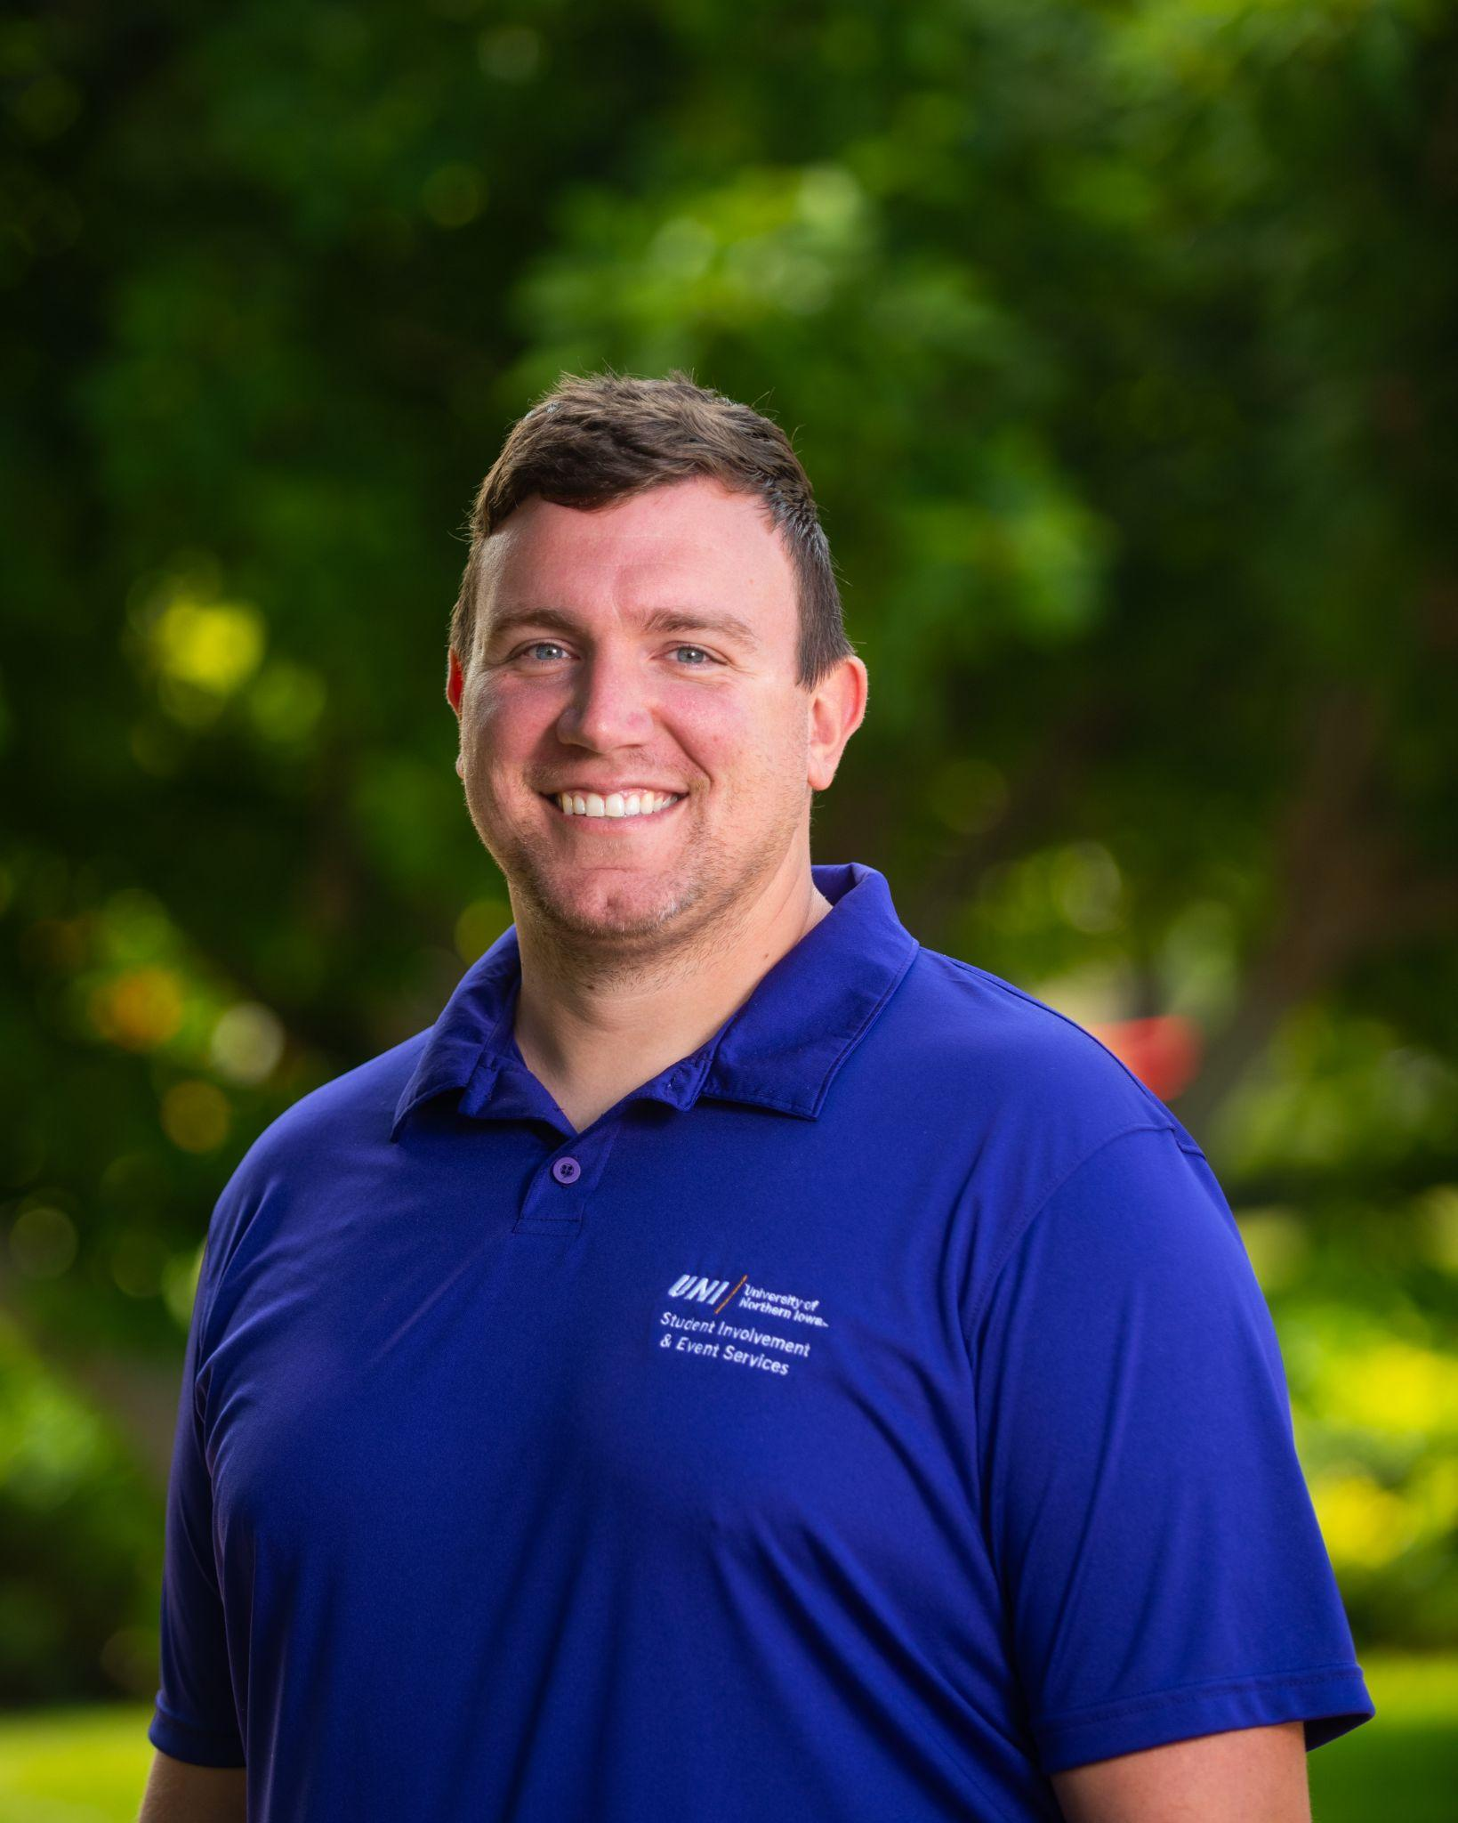
Student Involvement Staff
Tracy Ferguson
Campus Activity Boards Advisor
Campus Programs Coordinator
Social Media Content Creation Coordinator
Kelby Homeister
Campus Programs Coordinator
Student Organizations Event Coordinator
Equipment and Resource Contact
Notes:
Connie

Slide 6
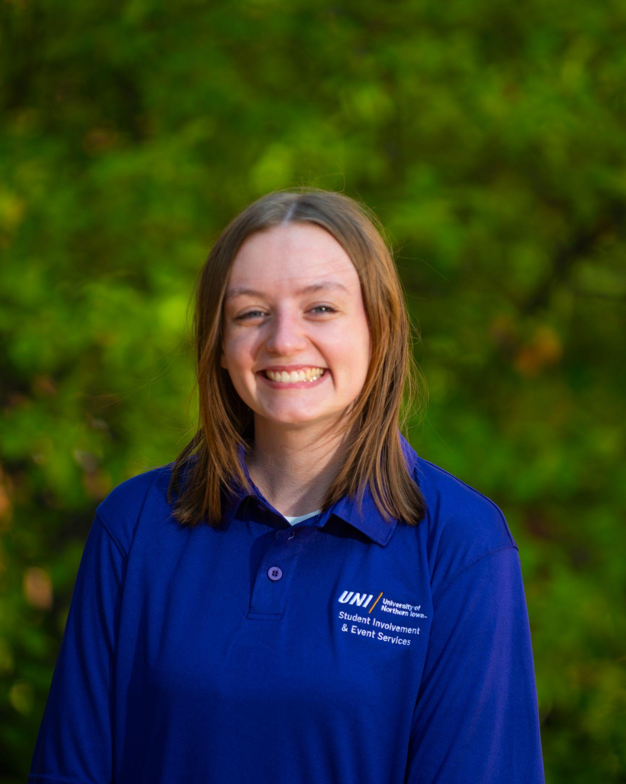
Graduate Student
Lauren Wirtz
Student Involvement
Student Organizations Event Coordinator
Notes:
Connie

Slide 7
Why are you here?
Importance of Annual Registration Meeting
Resources & Support to help you do what you do
Updating your organization, officer & Advisors information & social media information (we maintain the student org database)
Student Org Google Drive
Confirm with your advisor that they have completed the required Clery Act information. This training can be found on your elearning Blackboard. Please review and complete the training.
Benefits of Registered Student Organizations
Perks and privileges
We keep you informed (PLEASE READ & SHARE your monthly email)
Individualize student org meeting - please sign up so we do not have to chase you down.
Notes:
Connie

Slide 8
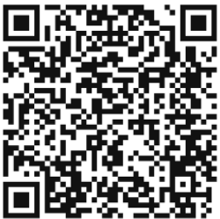
Next Steps: Sign up for an Org Meeting
Thirty minutes
Maximize the work you do
Set goals and objectives for the year
Notes:
Connie

Slide 9
Student Organizations Updates
Updates in the Student Organization Database
Importance of updating student organization information for the website
Review Constitutions: this should be done by your organization yearly
Importance of updating your rosters
The Panther Den (Located behind the Student Involvement Front Desk)
Copyworks orders will need to be picked up by student organizations in the store. They will no longer be delivered to the Office of Student Involvement.
Notes:
Carlos Be sure to update information for our website.

Slide 10
Student Org Registration Database Deadlines
9/12 - Deadline for Organizations to submit registration forms
9/19 - Deadline for Office Assistants to have new information entered into the student org database
Notes:
If you do not fill out the registration form, your organization will be eliminated

Slide 11
Student Org Google Drive
Google Drive Updates
Google announced that unlimited storage is no longer available for education customers. Beginning this October, UNI IT will begin the process of removing individual Google accounts of students/faculty/staff that are no longer members of the university community. If your organization utilizes any Google files from previous members, here are a couple of recommended steps to take.
MAKE COPIES OF HISTORICAL FILES YOUR GROUP WISHES TO MAINTAIN
If documents have been created and saved on individual accounts of members who are no longer part of the university community, please create electronic copies so you can retain access to the files. Once you have completed the next step, these files can be stored in your shared drive.
REQUEST STUDENT ORGANIZATION GOOGLE GROUP
We suggest that student organizations have an organizational email account where all folders and documents can be stored and shared permanently. To do so, please have your organization’s advisor complete the Student Organization Google Group Request form by initiating the following steps:
Select “New Google Group”
Note: Only full time faculty/staff can submit requests for Google Groups.
Your advisor will serve as the manager of the account and can add additional managers to populate who has access to the drive.
Contact servicedesk@uni.edu or 273-5555 if you have any additional questions about requesting a Google Group.
Notes:
Please create a google folder to keep all your organization information in.

Slide 12
Student Involvement and Alumni Association
The Office of Student Involvement and the Alumni Association are continuing to look for ways to support student organizations. One way is for us to capture each student orgs membership so that we can code student engagement on campus. The memberships will show up in every student's Panther FYI out of the classroom resume. On the Alumni side they will be able to gather alumni rosters for current student orgs looking to build relationships with their alumni. We will look to gather this information twice a year. (March and October).
Please submit your roster in excel or google sheets
We just need the following:
First name
Last name
UNI email address
Email this list to: involvement@uni.edu.
*Deadline is Oct. 17th
Questions: contact Carlos Frazier at carlos.frazier@uni.edu
Notes:
This is how we can track past members and keep them up to date with new information

Slide 13
UNI Pawprint
What is UNI PAWPRINT
Available through the Alumni and Foundation office
Contact person:
Derick Stoulil
Associate Director, Annual Giving Programs
Phone: 273-6033
Notes:
Funding platform…assist organizations with finding funding for programming

Slide 14
Student Care
Student Care serves as the centralized hub for the UNI campus community in providing coordinated care efforts to students experiencing a wide variety of challenges during their career.
As students and student leaders, we want to support you in your roles and your care for one another. However, we also recognize that you are a college student and you shouldn’t be solely responsible for your peers. If you have a friend who is struggling, please know we are here to help.
Connect a student to Care from the Dean of Students website.
Notes:
Allyson

Slide 15
Student Accessibility Services
Student Accessibility Services works with individual students to determine appropriate accommodations for their Academic and Campus Experience as well as for University Housing & Dining.
To support individuals with disabilities, please include the following statement in advertisements for programs or activities you are hosting:
If you need a reasonable accommodation to participate in this program/event/activity, please contact (sponsoring organization) at (email) prior to the event.
If you have questions about the accommodation a student requests please work with the Student Involvement team and/or Student Accessibility Services.
Sample of Accessibility Statement: Individuals with disabilities are encouraged to attend all UNI-sponsored events. If you are a person with a disability who requires a reasonable accommodation in order to participate in this program, please contact CAB at unicab@uni.edu at least one week prior to the event.
Notes:
Allyson

Slide 16
Student Conduct Code
Student organizations can also be held responsible through the Student Conduct Code, for behaviors on or off campus.
If your organization allegedly violates the Student Conduct Code,
We will communicate with your organizations president.
We communicate via UNI email.
You can have an advisor in the student conduct process.
Remind your members that they not only represent themselves but they also represent the organizations that they are a member of.

Slide 17
Student Conduct Code
The following factors will be considered when determining if the alleged policy violation was committed by a student organization or by individual(s):
How many of the members of the student organization were involved in the incident?
Did the incident occur in relation to an event sponsored by the organization?
Did a member(s) of the organization violate university policy(ies) at an event sponsored by the organization or in the course of the organization’s affairs, and fail to exercise reasonable preventable measures?
Did the organization’s leadership have knowledge that the event was going to occur?
What was the nature of the incident?

Slide 18
Student Conduct Code
Case Study:
On Friday afternoon you receive a message in the Taylor Swift Fan Club (TSFC) group chat about a party tonight. The message reads, “Pull out your sparkly boots and grab your friendship bracelets to swap, we’re hosting a party tonight. Location: Alli & Lindsay’s House (TSFC Headquarters), $10.00 pitch in for drinks required, members only.”
What might be concerning about this message?

Slide 19
Family Weekend
Family Weekend (September 12-14)
Nominate your Family to be named a Forever Family
Don’t forget to invite your parents, siblings, grandparents, friends - whoever you want to come spent the weekend with you.

Slide 20
University Relations & Marketing
Print Material
Copyworks discount / printing process
Logos
brand.uni.edu
Apparel & Giveaways
Work w/licensed vendors
Spread the Word
(+) Student Org Resources page
Photography
Notes:
Jess or partner

Slide 21
Student Org Catering
Things to know when having food or beverage at an event:
There are several University Policies that can impact your food and beverage purchases and/or reimbursement when using a university account.
13.17 Preparation and Service of Food and Beverages on Campus
Coca-Cola Contract
Serving food and beverages comes with some very real risk of foodborne illness if handled inappropriately. It is important that all potentially hazardous food and beverages (those which must be temperature-controlled in order to remain safe to consume) must be prepared in and/or provided by a licensed commercial food service or caterer when providing food or beverages for an open or advertised event.
Things you don’t think are a big deal, but can cause problems
Not using clean dishes or clean utensils, cross contamination both from an allergic reaction and from a bacteria standpoint
Not having the right equipment to heat or refrigerate food or beverage quickly enough, or not sanitizing prep areas or other things used to prepare the food or not getting food from a safe source.
Someone helping with the prep that is not feeling well.
Handling food with bare hands rather than gloves or tongs.
When providing food for just your group members (called a closed group) with a university account, you are not as restricted, but still want to be thoughtful about how you are handling any food components AND you need to be aware of the restrictions of the Coca-Cola Contract.
UNI Catering will offer all styles of catering including full serviced events.
Important to plan ahead and be a little flexible on dates and time.
Contact catering@uni.edu or call 319-273-2333 to see if UNI Catering is able to support your event.
Maucker Union Food Court, Chats and Essentials are available for pick up and you can used a Departmental Charge.
For more food options check out our catering website: https://uhd.uni.edu/dining/catering
For events under $250 with lower risk foods, you can order food from Approved Vendors without any additional approval.
For events over $250 and events with higher risk foods, you must get a catering exception regardless if it is from an approved vendor.
You must complete a catering exception for vendors that are not listed as an Approved Vendor for each event.
Steps to get a Food Truck for your event.
Steps for adding Approved Vendors.
Notes:
Carol or Jill

Slide 22
Student Org Catering
Easy Food Options:
Purchase food and beverages from Biscotti’s, Chats, Essentials or Maucker Union Food Court with a Departmental Charge.
Maucker Union Food Court (10:30 - 2:30 PM Monday - Friday) - Sandwiches, Sushi;
Godfather’s Pizza (10:30 - 5 PM Monday - Thursday, 10:30 - 2:30 PM Friday)
Pickup Orders from Maucker Union Online ordering available: https://uhd.uni.edu/dining/catering
Biscotti’s has great snack options like chips, popcorn, bulk candy, cookies, etc
Essentials and Biscotti’s will have ½ gallon Peak Tea, 2-liter Lemonade, 12 pks of canned Coke products and cases of bottled water.
For larger events, it is important to reach out early to ensure they will have everything you need.
Lots of Approved Vendors! If less then the $250, no approval needed if using an Approved Vendor. If you think you might go over $250 or are using a vendor that is not approved, do a catering exception.
For larger events or events that have food that requires the temperature control, make sure you plan head. Contact UNI Catering early in the process or get your catering exception in for approval! If you need help, we are always happy to help!

Slide 23
Reservations
What spaces are available for my group to reserve?
Maucker Union Lang Hall Auditorium
Wellness Recreation Center Rod Library
Outdoor Spaces Academic Buildings
Events in Maucker Union, Lang Hall Auditorium and Outdoor Spaces can be reserved online at reservations.uni.edu
Email: wrs-reservations@uni.edu
https://recreation.uni.edu/recreation-services-facilities-reservation
Notes:
Kelby

Slide 24
Reservations
What is the cost in reserving a space in Maucker Union?
In general, student organizations do not incur costs associated with utilizing meeting rooms and event spaces in Maucker Union.
Meeting rooms are equipped with in-room computers, projectors and video conferencing equipment available at no charge for you to use.
To use the in-room computer, you just need to turn on the projector and sign in using the mouse and keyboard.
Maucker Union Ballroom does have fees associated with projectors and select audio equipment. If you are planning an event, you can utilize your allocated NISG funding or request funding through NISG Non-Allocated Funds.
Notes:
Kelby

Slide 25
Marketing your Events in Maucker Union
Southwest Entrance Marquee:
Student Organizations can market events for up to two weeks. Submit event information to: https://docs.google.com/forms/d/e/1FAIpQLSe3-kmuaYC_t1V3oPqSYTt3YNLbrrQoFlr_GJr5CUQru71QpA/viewform
Interior Entrance Displays:
Student Organizations can market events for up to two weeks. Information on slide format and submission form can be found at: https://docs.google.com/forms/d/e/1FAIpQLSeELtrTxSVERzKjvWbmCpXqbYTdGRpO3rI9FRDG7J91HW-WMg/viewform
Student Involvement Calendar of Events:
Events reserved in EMS reservable spaces automatically populate to: https://eventschedule.uni.edu/
This is also a good resource to see what other events may be occurring across campus that could conflict with your events!
Calendar of all events
Notes:
Kelby

Slide 26
Event Management Safety
In the event of a medical emergency
1) Contact the building manager if applicable (in Maucker Union that would be full-time staff or evening/weekend building manager)
2) If there is not a building manager, call UNI Public Safety 319-273-2712 rather than 911. A UNI Public Safety Officer can be on the scene of the incident much faster to assess the situation and call for appropriate assistance.
Notes:
Kelby

Slide 27
Student Organization Funding
Notes:
Pam and Evan

Slide 28
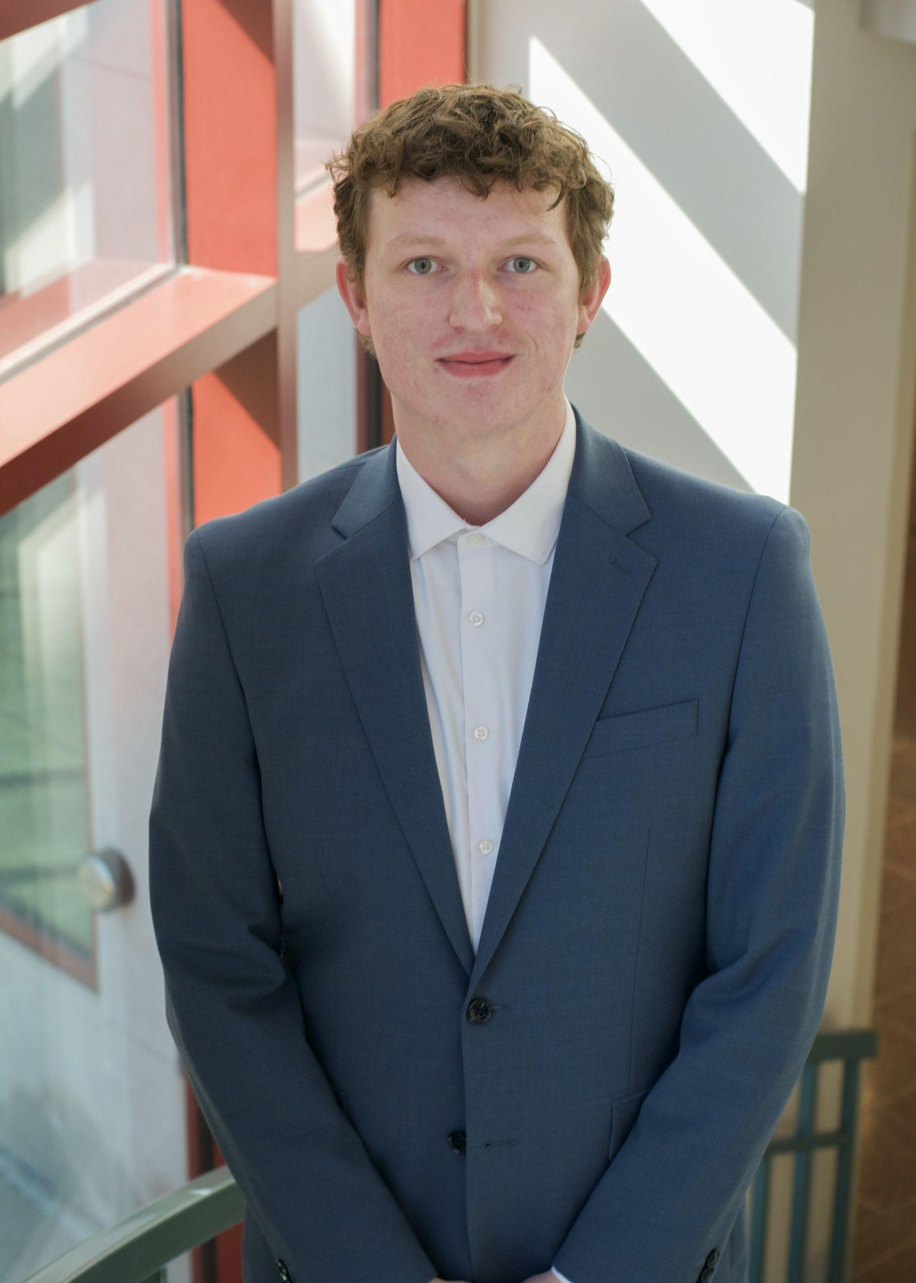
Types of Funding
Contact Information
Budgetary Process
Contingency Fund
Coca-Cola Fund
Intercollegiate Academic Fund
NISG Director of Administration and Finance
nisg-finance@uni.edu
Evan Winter

Slide 29
Overview of Funding Processes
Budgetary
Student organizations must submit a budgetary fund request form, including a detailed budget breakdown for events/expenses the organization wishes to receive funding for
This budgetary process will happen in the spring.
Non-Allocated (previously known as the Contingency fund)
Funds similar items to budgetary allocations
Funding decision is based on merit and availability throughout the fiscal year (July 1st 2024- June 30th 2025)
Coca-Cola
The only funding source for food
Can also fund travel and other events benefitting the campus
Intercollegiate Academic Fund
Used for research, academic presentations and competitions
Must be associated with an academic department

Slide 30
The Budgetary Process
We are back to a budgetary review process
Organizations are required to submit a form including a budget breakdown for fundable expenses they wish to receive funding for
Student orgs are emailed the results after review by the budgetary committee and after the Senate votes on the budget
2024-2025 budgetary allocations are linked here, but are also available to view at anytime on the Northern Iowa Student Government website

Slide 31
The Non Allocated Fund
Year-round funding source
Does not fund
Food or beverages
Events not open to all students
Items that do not stay with the club
Ex. t-shirts for members (not used as jerseys or uniforms)
Application based; link can be found here
Applications received less than two weeks prior to the event are subject to automatic denial
More money can be accessed by collaborating with other student organizations

Slide 32
Intercollegiate Academics Fund
Funding from the Provost office for research, competition, and academic presentations
There is generally a large amount that can be funded, but the application process is more complicated than other sources
Department Heads and Student Organization Advisors are able to help you through this process
The link for more information about this fund can be found here

Slide 33
The Coca-Cola Fund
The money for this fund comes from the university’s exclusivity agreement with Coca-Cola
Funding guidelines are more flexible than the contingency fund
This is the only fund that will grant money for food (or anything food-related)
More money can be accessed when collaborating with other student organizations
The application can be found here
Applications received less than two weeks prior to the event are subject to automatic denial

Slide 34
Coca-Cola Product Request
Free Coca-Cola product is available for student organizations that meet the guidelines
This product allocation is a set amount and on an annual basis
Groups are able to request product for future events as soon as they have confirmed event details set
For more information, or to fill a request, use this link
When placing a request, enter the quantities in 12 packs of soda and 24 packs of water, planning for 1 item per person attending the event
Ex. a request for 1 case of Coke will provide for 12 people, so if there is a 12 person event, you request 1

Slide 35
Accessing Funding
Applications for any type of funding are required at least two weeks before the event takes place
Applications are subject to automatic denial if this deadline is not met
After funding is approved, organizations are required to meet with Pam Creger to access the monies
If you have any questions about how to access funding once it is distributed, please contact Pam Creger at pamela.creger@uni.edu
Pam Creger’s meeting schedule for 2024-2025:
In person meetings can be scheduled Tuesdays/Wednesdays 8-3:30pm
Available for meetings via zoom Monday, Thursday, Friday 8-3:30 pm

Slide 36
Student Travel
Student Organization Travel with NISG Allocated Funding
Visit Office of Student Involvement website for information on How to Access Funding For Travel
Some expenses can be prepaid using a university credit card, others will have to be paid out of pocket by the student and reimbursed upon completion of the travel
Contact Pam Creger to schedule a planning meeting as soon as possible - ideally 30-45 days prior to travel
A travel request must be created in the university travel system via OBO Service Hub - this will be done by Pam Creger if NISG funding is being utilized for the travel
Student Organization Travel without NISG Allocated Funding
A travel request must be created in the university travel system via OBO Service Hub by the student organization advisor or a designee in their department is responsible for creating this trip
NOTE: When student organizations are traveling in the Cedar Falls/Waterloo area, a travel request form is only required if the group will be renting space at the intended venue/location.

Slide 37
Item specific Purchasing Information
Organization Name Badges - can be purchased through University Relations using a department account. Pam Creger can help with ordering if you have funding, or a department secretary can assist.
Organization Tablecloths with logo for tabling events - must be ordered through a licensed vendor. Pam Creger can help with ordering
Orders for items with UNI or organization logos must be purchased through a licensed vendor
Items paid for with university funding that are considered technology or electronics must be vetted through IT. Plan accordingly for additional lead time when purchasing

Slide 38
Apparel purchases
If you want to purchase t-shirts, uniforms or any type of apparel with NISG funding, send an email to pamela.creger@uni.edu including the following information:
Type of apparel (t-shirts, team jersey etc)
Business reason/justification for the apparel (worn as uniform, required for members to wear at sponsored events)
Estimated cost per item
Total anticipated cost
Your request will be forwarded to the NISG Organization and Finance committee for review and approval
If approved, you will be required to submit a list of each person receiving apparel, the dollar amount of the item received
All apparel purchases must be purchased through a licensed vendor

Slide 39
Notes:
Kristina

Slide 40
Overview
In partnership, the University of Northern Iowa and the Volunteer center of the Cedar Valley (VCCV) connect students to volunteer opportunities in the community.
The VCCV utilizes an online database that displays over 50 ongoing volunteer opportunities. There are over 180+ member organizations to connect with!
Both individuals, student organizations, staff, and faculty can collaborate and utilize us as a resource for volunteer needs.

Slide 41
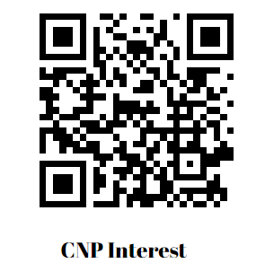
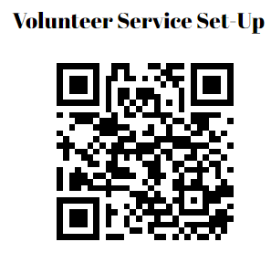
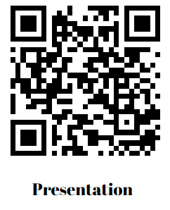
WE Can Help!
Learn about the national Certified Nonprofit Professional (CNP) Credential at UNI. (Current participation in a student organization gives you and your members an advantage in earning a CNP).
Assist in setting up volunteer service activities for your organization or register for natural disaster relief training.
10-15 minute presentation at your organization meeting with more details about Community Engagement and the Volunteer Center of

Slide 42
Contact Us
Volunteer Center of Cedar Valley
Email: information@vccv.org OR
Location on Campus: Maucker Union
Monday: 10am- 4:30pm
Thursday: 8am-1:30pm, 3:30-4:30pm
@volunteercenterofcedarvalley
@volunteercenter_CV
@volunteercentercv
Office of Community Engagement
Email: community.engagement@uni.edu
Location: Human Performance Complex 107
Monday-Friday: 8 am- 4:30 pm
@UNIEngagement

Slide 43
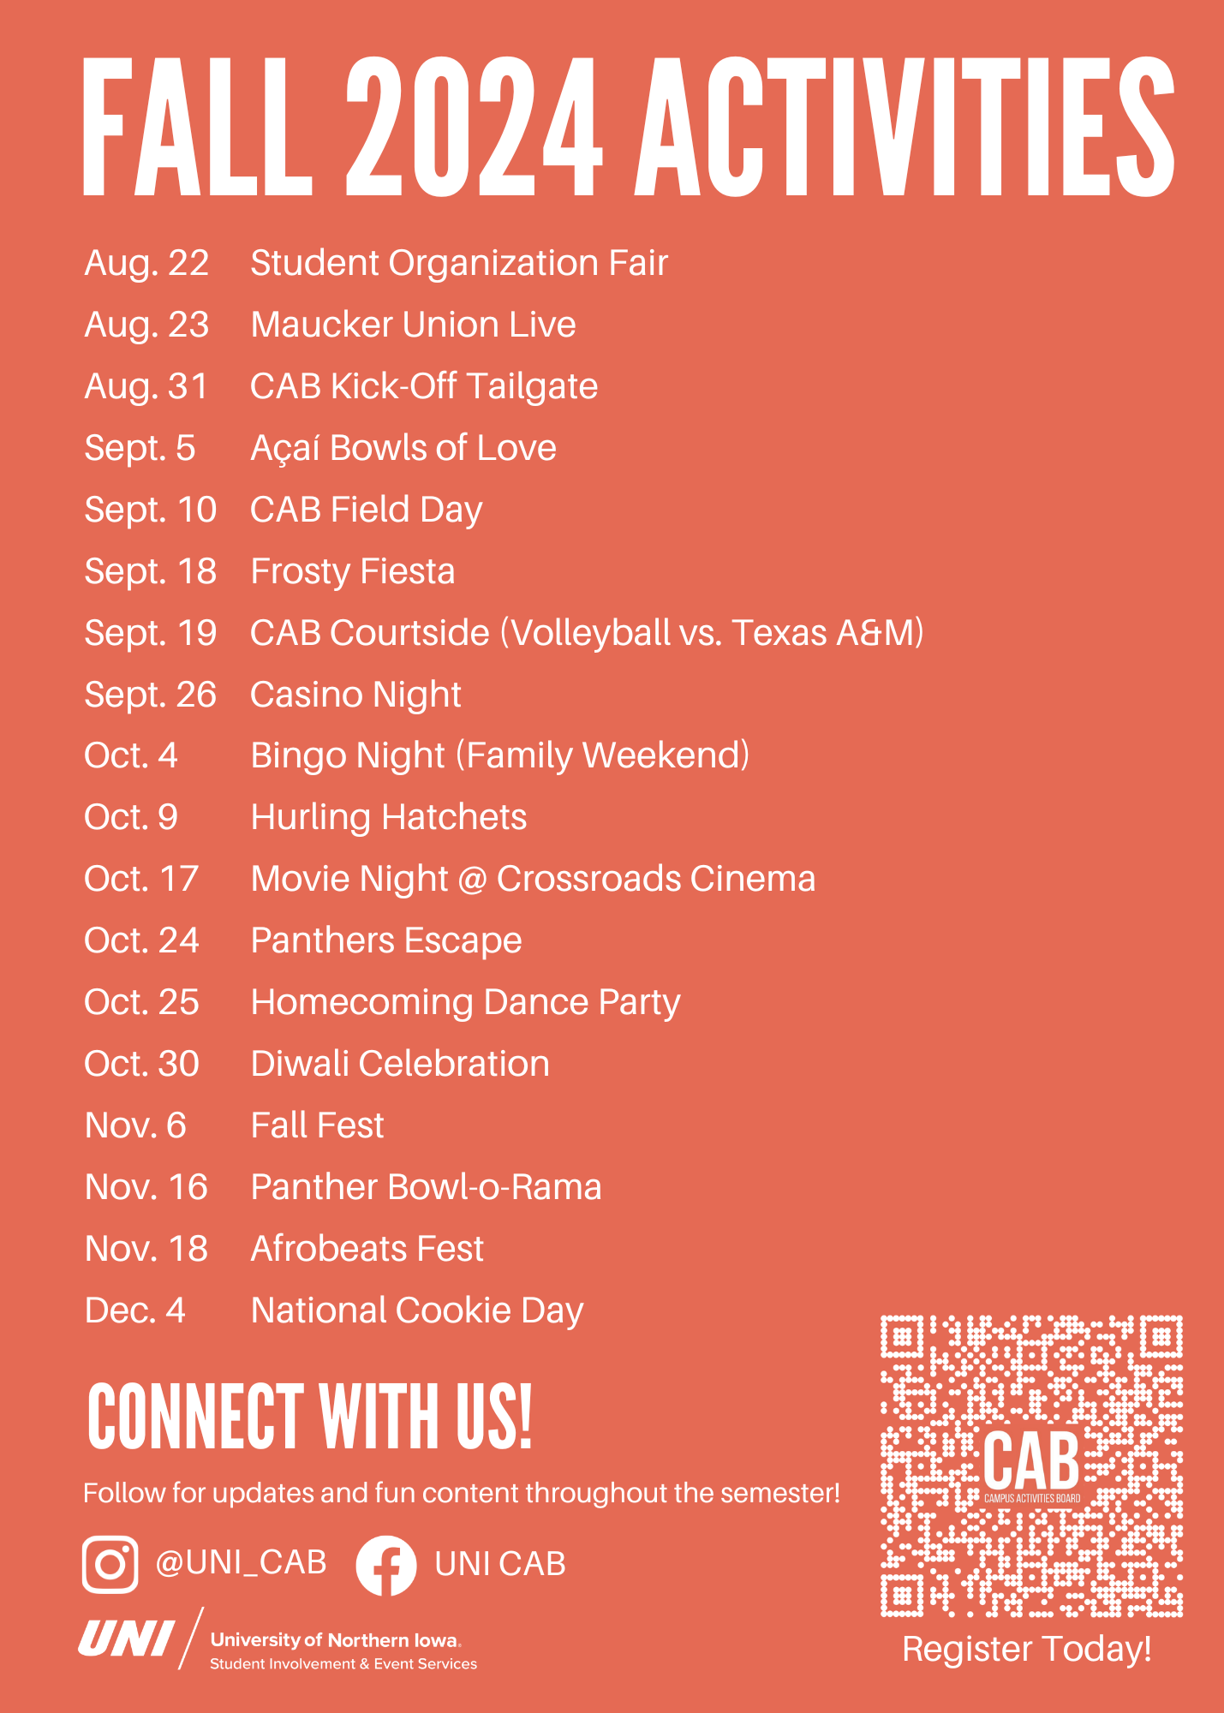
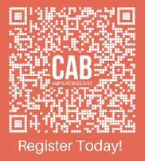
Come to CAB events as an organization. Let us know if your group is coming and we can save some seats for you.
Use the QR Code to Register for events
Notes:
Tracy

Slide 44
Content Creator
The Student Involvement Content Creator, Emijah Jones, can assist Student Organizations with the creation of any graphics for marketing purposes.
Email Emijah at involvementmarketing@uni.edu to request help
PLAN AHEAD - Send requests 2 weeks prior to the date you need the graphics to be completed
See list below for marketing opportunity ideas we can assist you with.
Social Media Marketing Request Form - An opportunity for Student Organizations to send in Social Media requests so they are able to get reposted on the UNI Student Involvement Social Media Accounts.
Button Maker - Request a time slot or request help with a button Design
Bubble Poster - Request a bubble poster to be printed and hung up, or request help with a bubble poster design
Social Media Templates - Multiple templates to help student organizations create social media graphics.
Maucker Union Marquee (Outdoor Electronic Message Board) - A request form for student organizations to have their graphic appear on the outdoor electronic message board in Maucker Union
Computer Lab Monitor Screensavers - A request form for student organizations to have their graphic appear on the computer lab monitor screensavers.
Maucker Union Entrance Displays (Indoor Digital Signage) - A request form for student organizations to have their graphic appear on the indoor digital signage un Maucker Union.
Notes:
Tracy

Slide 45
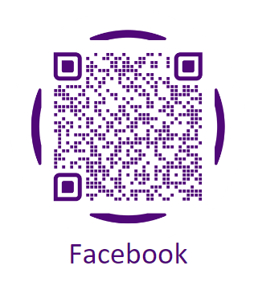
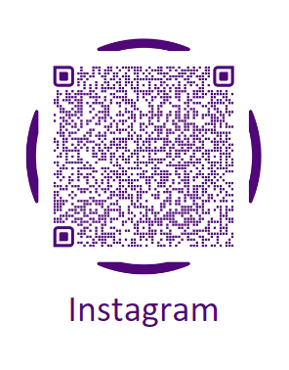
Follow us / Share your events on Social Media
Notes:
Tracy

Slide 46
Tips for Working With Your Advisor
Advisors Role
Attending Meetings
Holding one on one meetings with executive officers
Policies & Procedures
Resource & Guide to University offices
Goal Setting
University Student Travel Policy
Leadership Development
Mediation (between members, university departments, ect..)
Financial
Representative to campus community
Be familiar with national affiliates
Notes:
Carlos

Slide 47
Student Involvement Resources
Programming supplies
Yard games
Signs
Button maker
Sound system
Student Org Work Space
Behind the student involvement front desk
Monthly Emails
Event Planning Checklists
Student Organizations Resources page
Notes:
Carlos

Slide 48
Movie Copyrights
The Chart below is a quick guide to helping you understand if you need permission to show the film without copyright:
Yes, you need to obtain a copyright: | No, you do not need a copyright:
If the screening is open to the public, such as showing a film to the community for cultural enrichment If the screen is in a public space where access is not restricted, such as an instructor showing a film to a class for curriculum related purposes in a public or unrestricted location If person attending are outside the normal circle of family and acquaintances, such as showing a film to a student org, or showing a film for a class but inviting others to attend | If privately viewing the film in your place of residence with friends If an instructor is showing the film to officially registered students in a classroom, where content of film directly relates to the course If the film is streamed from the Kanopy database, rented from Rod Library (assuming Public Performance Rights are available), or a Public Domain Film and no admission fee is charged
Older movies will be about $500 and newer ones $1000. This might be unfeasible for your organization, so consider collaborating with other organizations to split the cost or working with CAB.
Notes:
Carlos

Slide 49
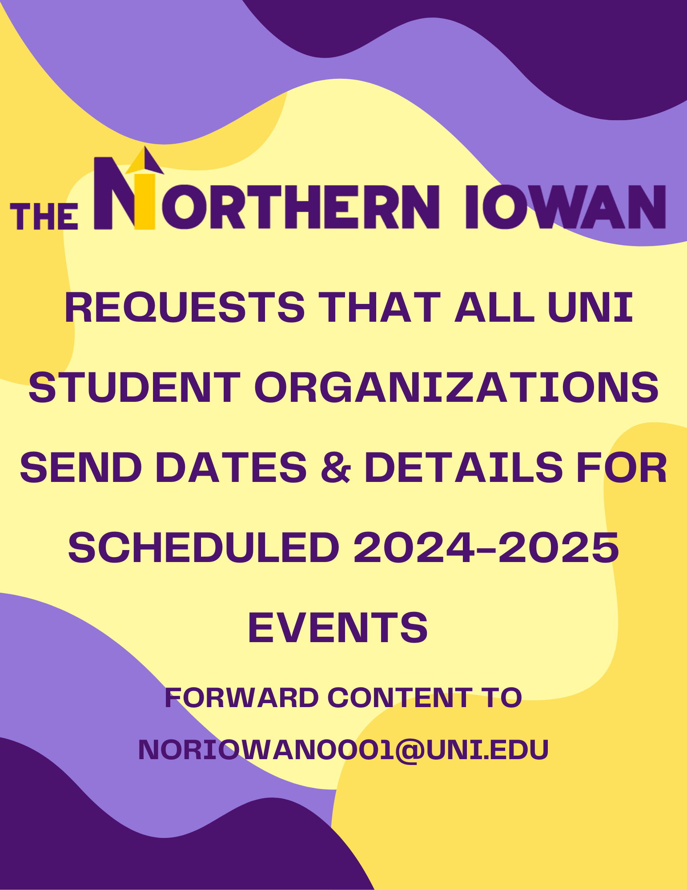
Notes:
Carlos

Slide 50
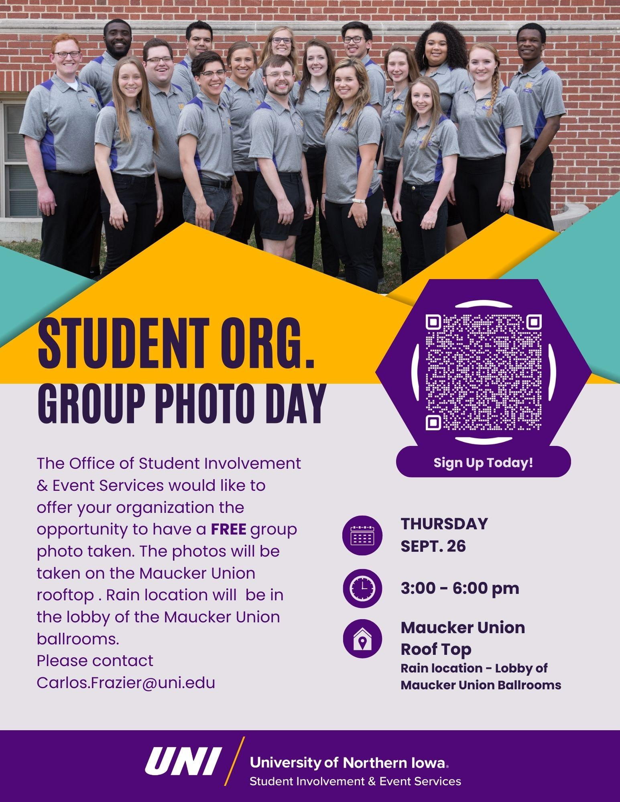
Notes:
Carlos

Slide 51
Thank you for coming!

